Slide 1


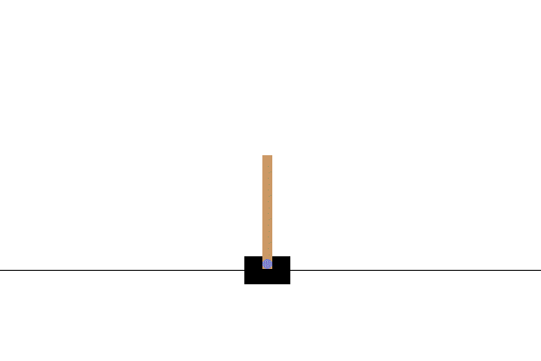
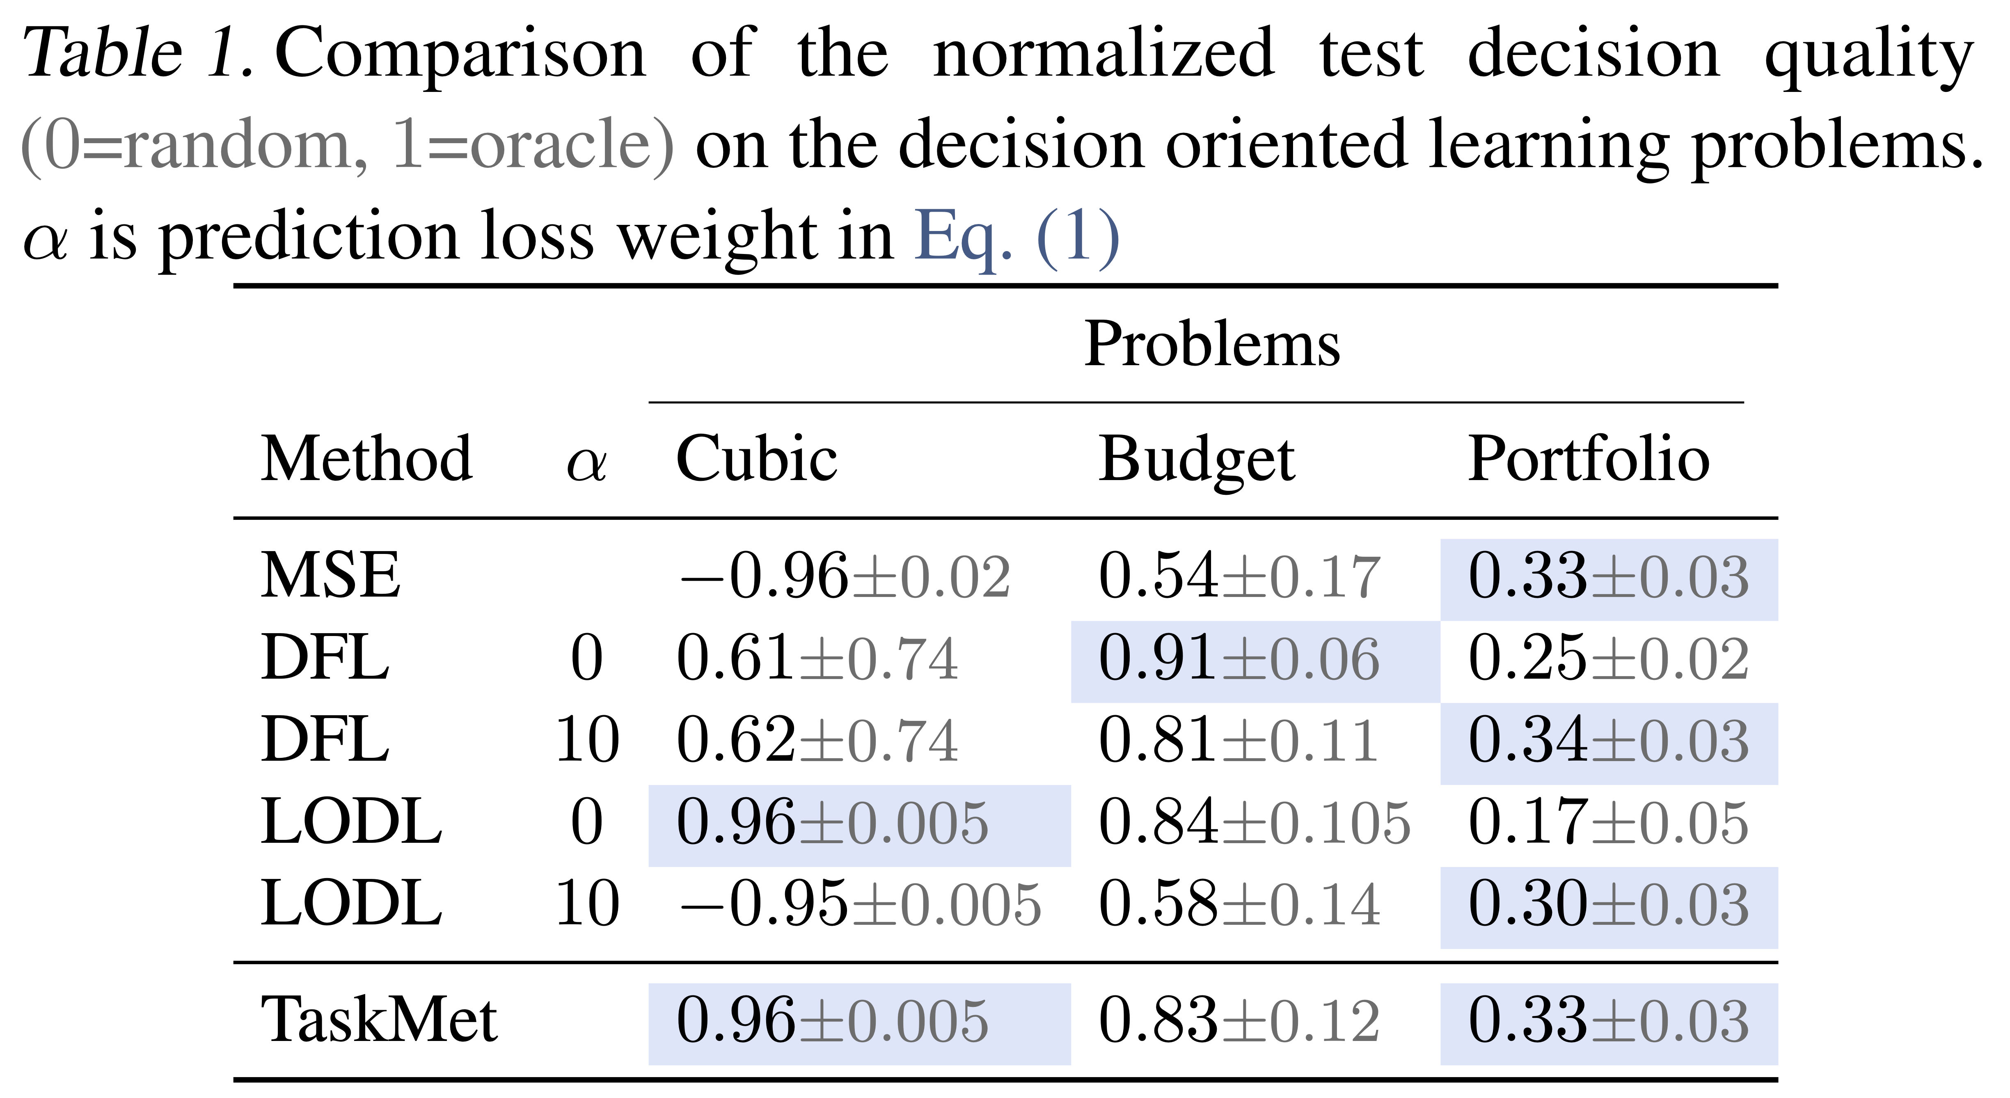

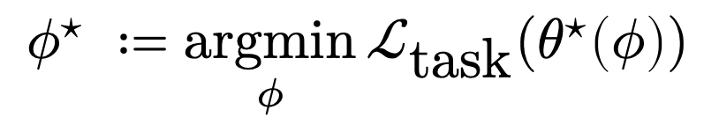

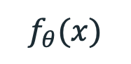
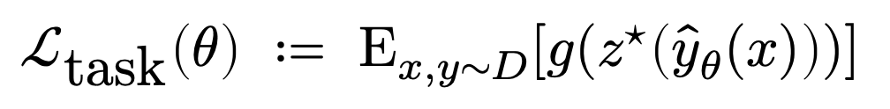
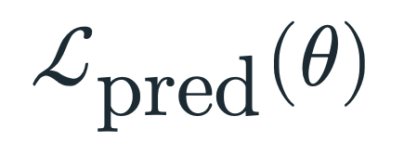

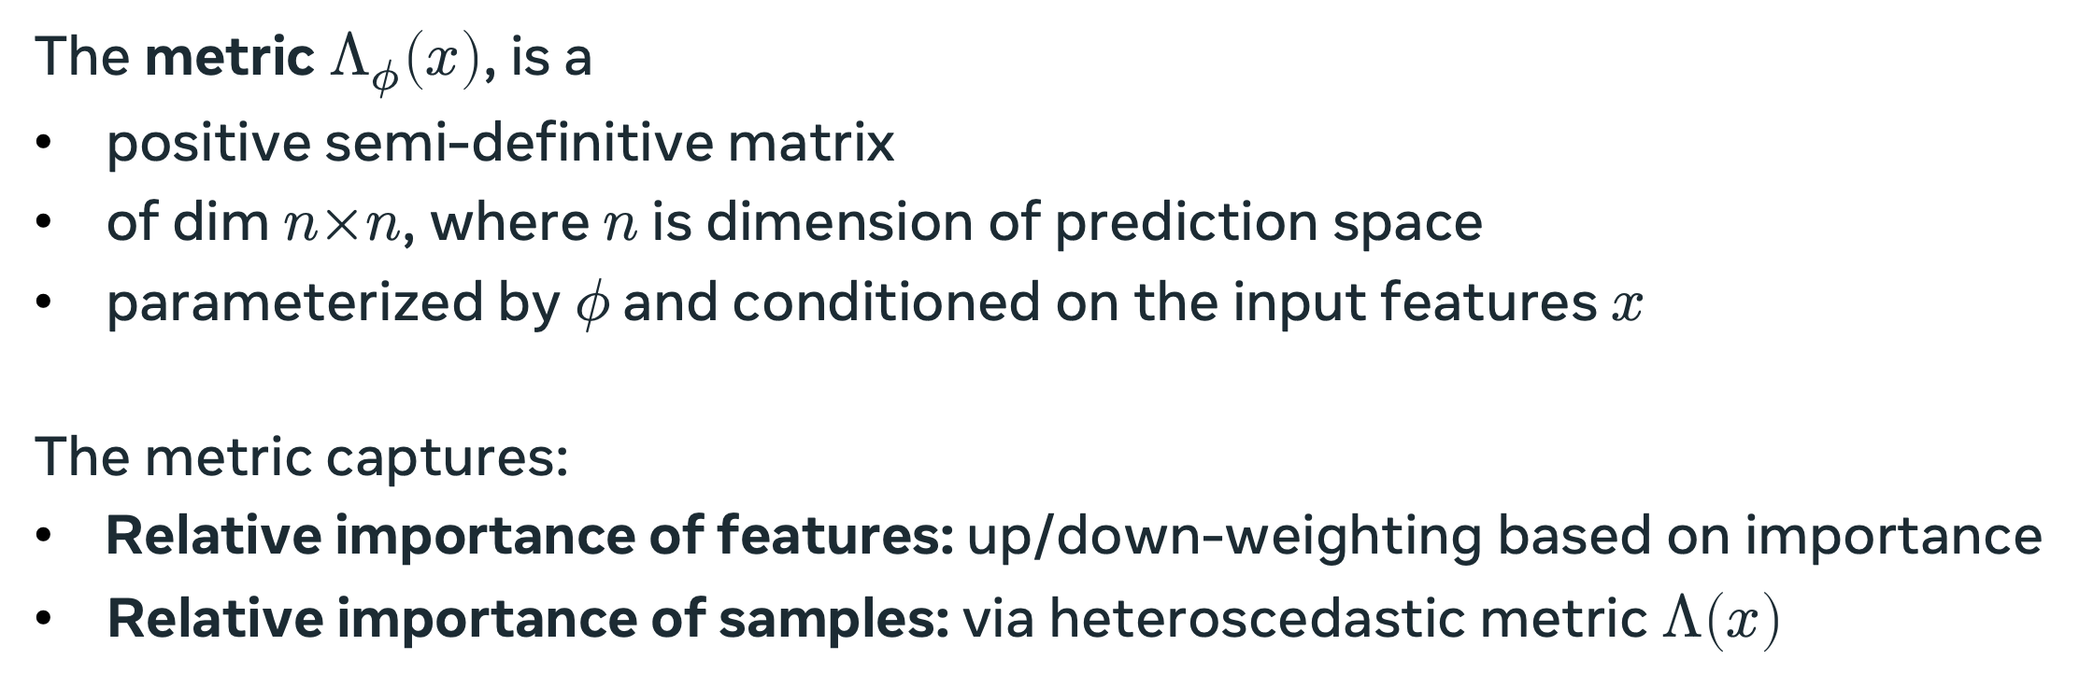


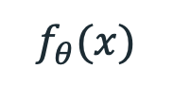
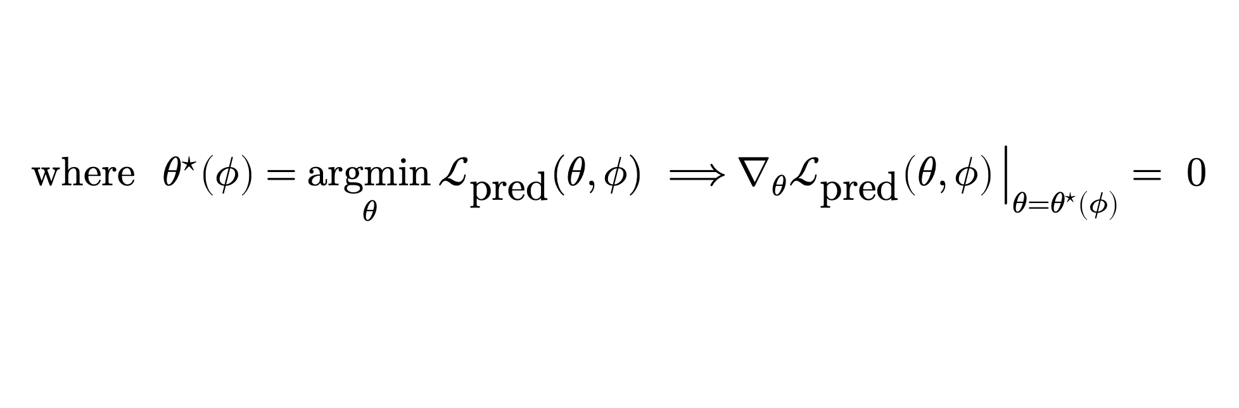

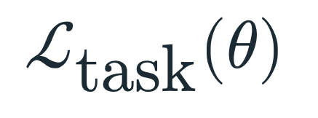


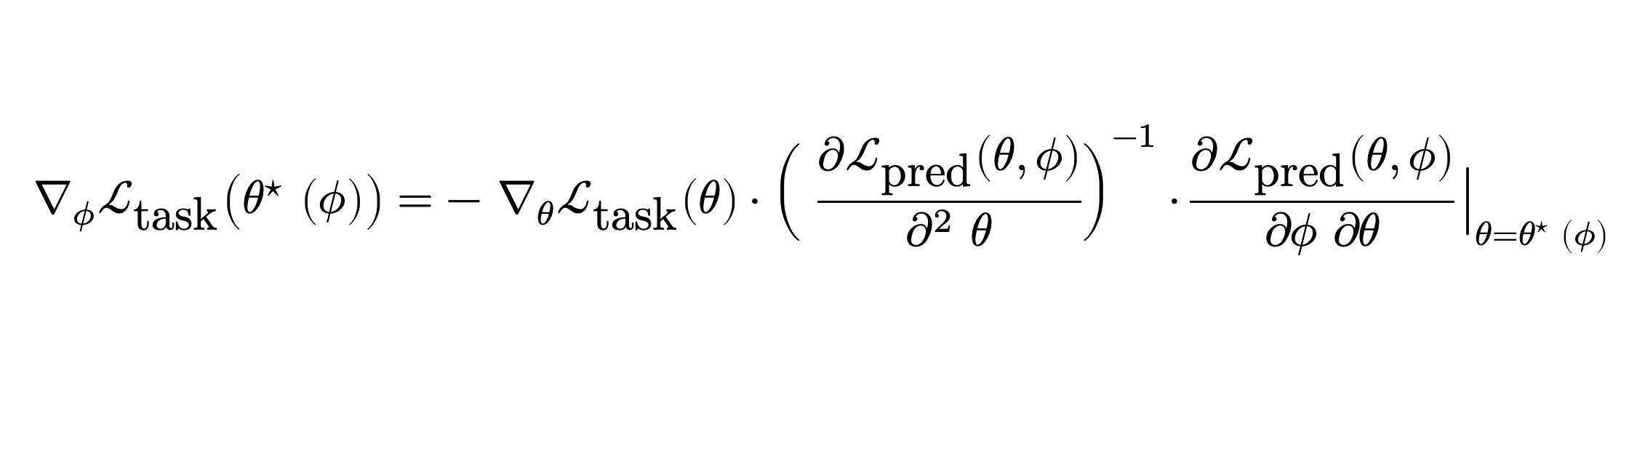

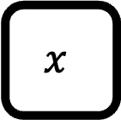
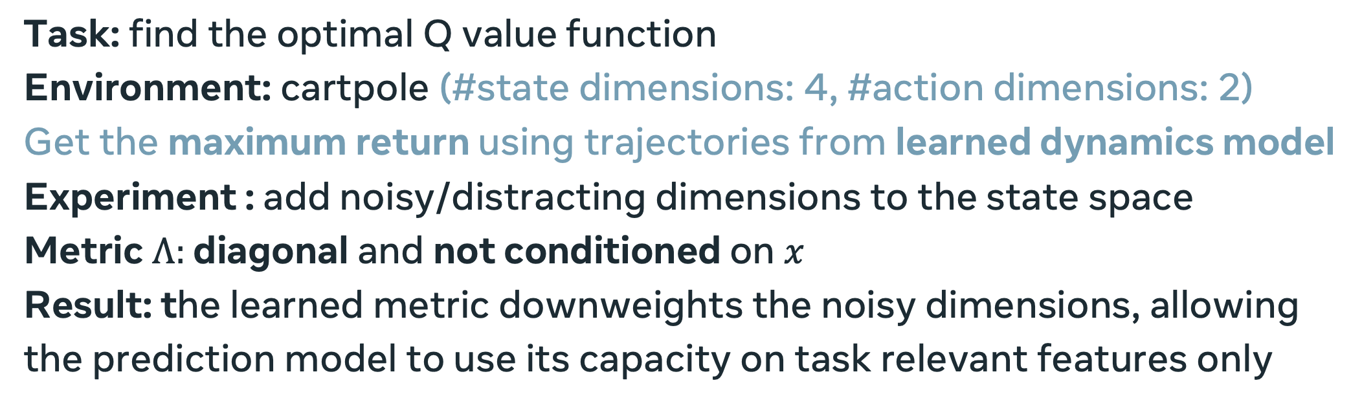
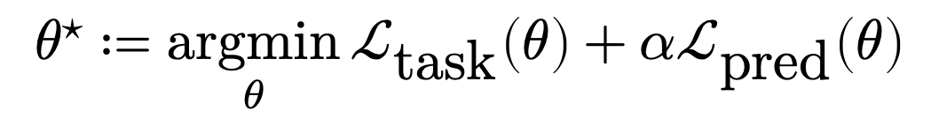
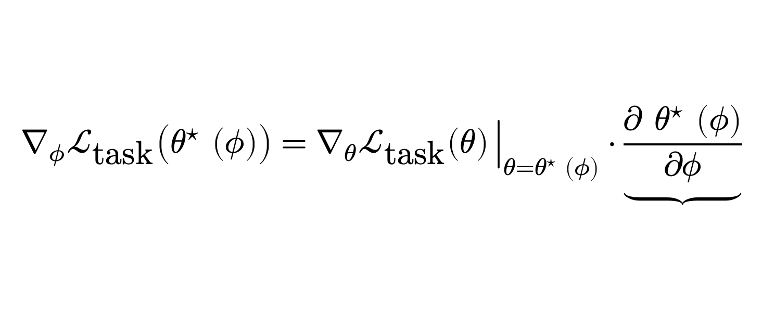
TaskMet: Task-Driven Metric Learning for Model Learning
Dishank Bansal, Ricky T. Q. Chen, Mustafa Mukadam, Brandon Amos
Motivation: training models for downstream tasks
Our paper: task-based metric learning (TaskMet)
Experiments: model-based RL
Challenge: models trained with prediction losses may struggle on downstream tasks
Why? objective mismatch, approximation errors, limited capacity, data
input
model
prediction
(parameterized) prediction loss
📚 Control-oriented model-based reinforcement learning with implicit differentiation. Nikishin et al., AAAI 2022.
$$x$$
$$f_{θ}(x)$$
$$\hat{y}$$
$$ℒ_{\text{pred}}$$
$$ℒ_{\text{task}}$$
Our contribution: a task-driven end-to-end metric learning framework for training prediction models. This provides:
A method to train models for better performance on the downstream task
A method to learn a loss function using task information, which is then used to train prediction model
Insight: use the task signal to shape the metric of a prediction loss, not the model
Why? 1. Retains the prediction task: the metric emphasizes the important parts 2. Generalization: the metric can be controlled to not deviate too much
Task: find the optimal Q value function
Environment: cartpole (#state dimensions: 4, #action dimensions: 2) Get the maximum return using trajectories from learned dynamics model
Experiment : add noisy/distracting dimensions to the state space
Metric $Λ:$ diagonal and not conditioned on $x$
Result: the learned metric downweights the noisy dimensions, allowing the prediction model to use its capacity on task relevant features only
Generalized Mahalanobis loss as the prediction loss
We use a generalized Mahalanobis loss parameterized by the metric $Λ_{φ}$
A model trained with MSE may still perform suboptimally on the downstream task. TaskMet trains the model to achieve minimal task loss.
$ℒ_{\text{pred}}\left(θ,φ\right)≔ Ε_{x,y \sim D}\left[{\left\|f_{θ}\left(x\right)−y\right\|}_{Λ_{φ}(x)}^{2}\right] =Ε_{x,y \sim D}\left[{\left(f_{θ}\left(x\right)−y\right)}^{T}Λ_{φ}(x)\left(f_{θ}\left(x\right)−y\right)\right]$
The metric $Λ_{φ}\left(x\right)$, is a
positive semi-definitive matrix
of dim $n×n$, where $n$ is dimension of prediction space
parameterized by $φ$ and conditioned on the input features $x$
The metric captures:
Relative importance of features: up/down-weighting based on importance
Relative importance of samples: via heteroscedastic metric $Λ\left(x\right)$
cart position
pole angular velocity
cart velocity
pole angle
noise →
Examples of two-stage settings
High
Metric value
models/predictions
downstream tasks
Low
click-through rates
recommendations
item demands/utilities
budget allocation
TaskMet
OMD
MLE
Metric value is highest for the pole angle — most indicative of the reward
MDP state transitions
optimal control
Experiments: decision-oriented model learning
📚 Decision-Focused Learning without Differentiable Optimization. Shah et al., NeurIPS 2022.
future stock prices
portfolio optimization
End-to-end metric learning for model learning
Setup: model predictions parameterize a decision-making optimization problem Example: portfolio optimization
next word (LLMs)
chatbots (RLHF)
The key idea of the method is to learn an optimal metric end-to-end with a given task, which is then used to learn model via prediction loss.
We use bilevel optimization for the metric and model learning:
decision quality (negated) portfolio returns
portfolio allocation
(MSE, likelihood)
$$ℒ_{\text{pred}}(θ)$$
$$≠$$
$$ℒ_{\text{task}}(θ)$$
$$φ^{⋆} ≔\underset{φ}{argmin}{ℒ_{\text{task}}(θ^{⋆}\left(φ\right))}$$
$$ℒ_{\text{task}}\left(θ\right) ≔ Ε_{x, y∼D}[g(z^{⋆}\left({\hat{y}}_{θ}(x)\right))]$$
stock features
$$\text{w}\text{here} { θ}^{⋆}\left(φ\right)=\underset{θ}{argmin}{ℒ_{\text{pred}}(θ, φ)} ⟹∇_{θ}ℒ_{\text{pred}}\left(θ, φ\right){\left.​\right|}_{θ=θ^{⋆}\left(φ\right)}= 0$$
Cubic setting
predicted stock price model
Background: task-based learning
Predict utilities with a linear model for a downstream maximization task
Severe modeling errors — must focus on high-utility points
Takeaway: our learned metric tilts the model to control the maximum prediction
📚 Task-based end-to-end model learning in stochastic optimization. Donti, Amos, and Kolter, NeurIPS 2017.
📚 Decision-Focused Learning for Combinatorial Optimization. Wilder et al., AAAI 2019.
📚 Smart ”Predict, then optimize.” Elmachtoub and Grigas, Management Science 2022.
Implicit differentiation for end-to-end metric learning
We need calculate $∇_{φ}ℒ_{\text{task}}\left(θ^{⋆}\left(φ\right)\right),$ to find $φ^{⋆}$
Key idea: optimize the model with the task loss
$$∇_{φ}ℒ_{\text{task}}\left(θ^{⋆} \left(φ\right)\right)=∇_{θ}ℒ_{\text{task}}\left(θ\right){\left.​\right|}_{θ=θ^{⋆} \left(φ\right)}⋅\underbrace{\frac{∂ θ^{⋆} \left(φ\right)}{∂φ}}$$
normalized decision quality (0=random, 1=oracle)
TaskMet
MSE
Ground Truth
input
model
prediction
$$ℒ_{\text{pred}}$$
calculate using Implicit Function theorem
weight of MSE term
$$x$$
$$f_{θ}(x)$$
$$\hat{y}$$
$$θ^{⋆}≔\underset{θ}{argmin}{ℒ_{\text{task}}\left(θ\right)+αℒ_{\text{pred}}\left(θ\right)}$$
$$∇_{φ}ℒ_{\text{task}}\left(θ^{⋆} \left(φ\right)\right)={− ∇}_{θ}ℒ_{\text{task}}\left(θ\right)⋅{\left( \frac{∂ℒ_{\text{pred}}\left(θ, φ\right)}{∂^{2} θ}\right)}^{−1}⋅\frac{∂ℒ_{\text{pred}}\left(θ, φ\right)}{∂φ ∂θ}{\left.​\right|}_{θ=θ^{⋆} \left(φ\right)}$$
end-to-end learning
$$ℒ_{\text{task}}$$
We approximately solve this with a conjugate gradient method
Drawbacks of standard task-based losses
1. The model may overfit to the task and be unable to generalize to other tasks e.g., one task may care about colors while another may care about edges 2. The model may forget how to predict in the original space e.g., the task loss may just care about magnitudes rather than absolute values
MSE puts equal weight on all points
TaskMet prioritizes accurate prediction of high utility points

